Slide 1



Mental Health in Tech
Visualizing Survey Results on Burnout and Workplace Well-being
OSMI MENTAL HEALTH IN TECH SURVEY
16010123012 Aaryan Sharma
16010123017 Aditey Kshirsagar
16010123023 Aditya Baheti
Notes:
1

Slide 2
Objectives of Analysis
Prevalence Analysis
1
Measure the prevalence of mental health conditions across the tech workforce.
Work Performance Impact
2
Examine how mental health affects productivity, absenteeism, and job performance.
Key Factor Identification
3
Identify how remote work, company size, and demographics shape employee well-being.
Workplace Support Evaluation
4
Assess the availability and awareness of mental health resources and benefits.
Actionable Insights
5
Translate findings into evidence-based recommendations for HR leaders and policymakers.
Notes:
2

Slide 3
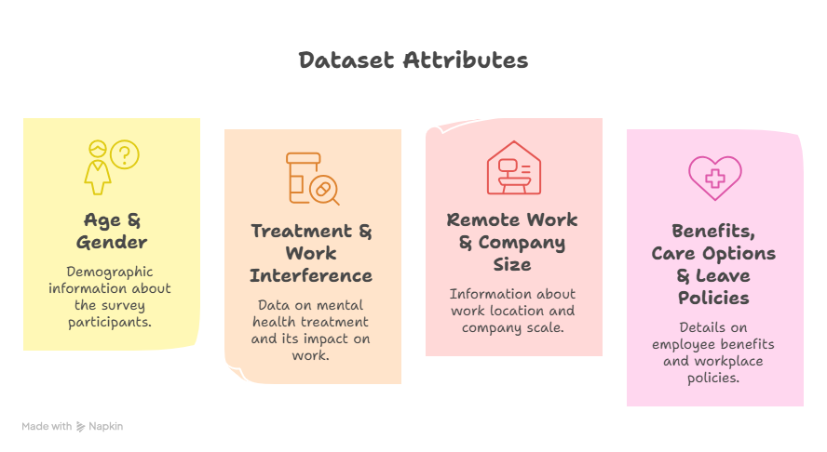
Source of Data & Metadata
Dataset Overview
OSMI Mental Health in Tech Survey — a cross-sectional, survey-based dataset collecting self-reported responses from tech industry employees globally on mental health experiences and workplace conditions.
Key Attributes
Age & Gender
Treatment & Work Interference
Remote Work & Company Size
Benefits, Care Options & Leave Policies
Notes:
3

Slide 4
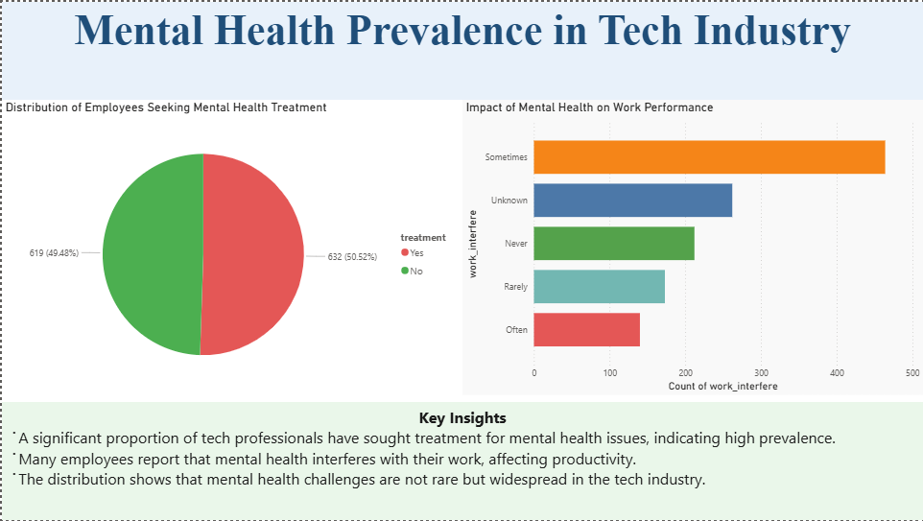
Notes:
4

Slide 5
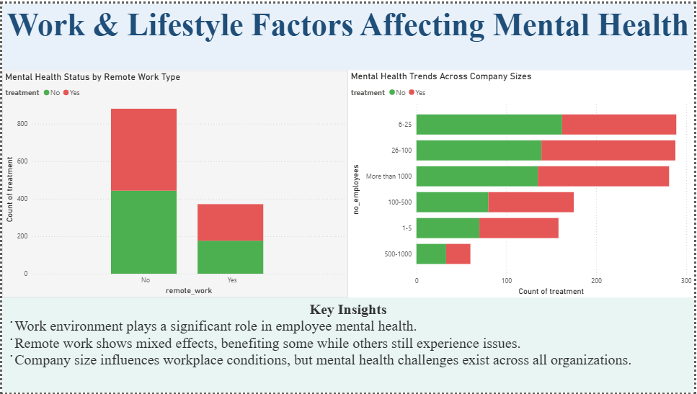
Notes:
5

Slide 6
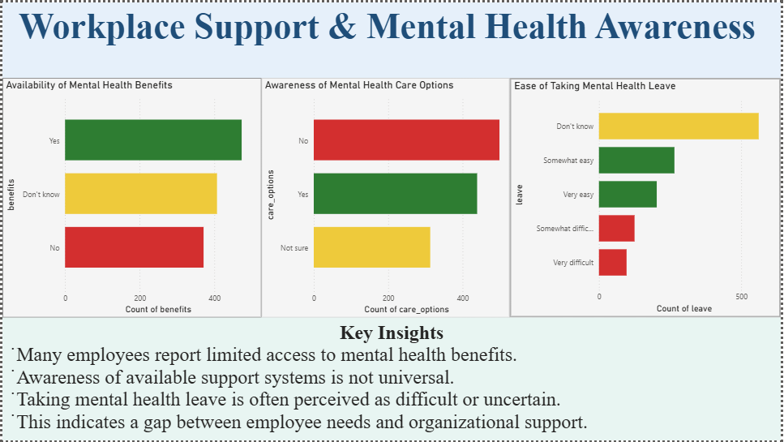
Notes:
6

Slide 7
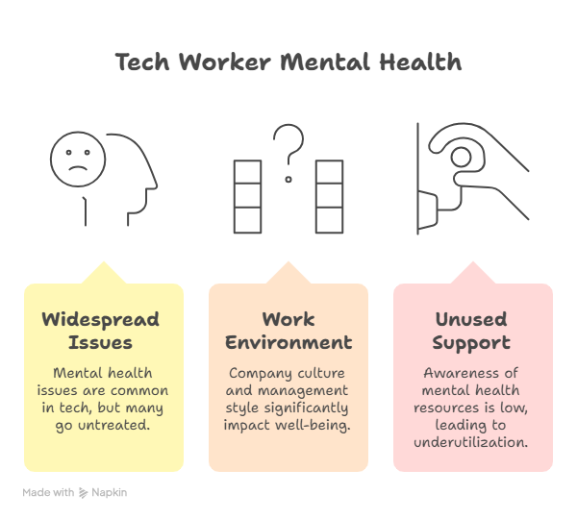
Key Findings
Mental health issues are widespread in tech
The data consistently shows that a substantial share of tech workers experience mental health conditions, yet many remain untreated due to stigma or lack of access.
Work environment is a decisive factor
Company culture, management style, remote work flexibility, and company size all play significant roles in shaping employee well-being outcomes.
Support systems exist but go unused
Awareness of available mental health resources remains low. Even when benefits exist, employees often do not know about them or feel unable to use them.
Notes:
7

Slide 8
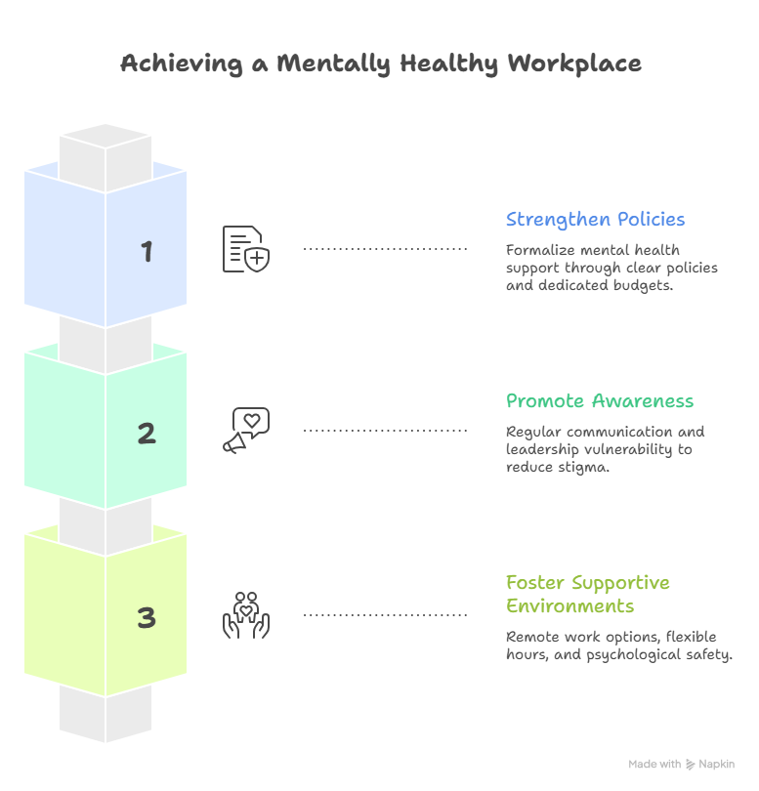
Conclusion & Recommendations
Strategic Recommendations
01
Strengthen Mental Health Policies
Organizations should formalize mental health support through clear policies, dedicated budgets, and trained HR personnel.
02
Promote Awareness & Open Dialogue
Regular communication about available resources, combined with leadership modeling vulnerability, can reduce stigma and increase uptake.
03
Foster Flexible, Supportive Environments
Remote work options, flexible hours, and a culture of psychological safety are proven to improve both well-being and productivity.
Notes:
8

Slide 9
Thank You

